Slide 1
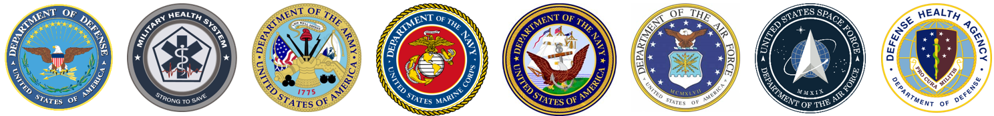
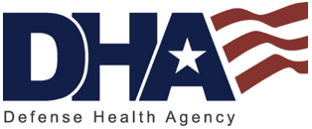
Regulations
Tri-Service Hearing Technician
4.2 Certification Course

Slide 2
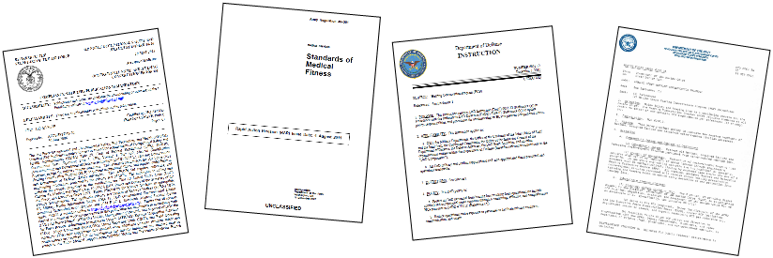
Regulations
Learning Objectives
3.3.1 Recognize the importance and application of hearing conservation program regulatory requirements
Federal – OSHA/NIOSH
State
Department of Defense
Service Specific
Local level - including SOPs
Tri-Service Hearing Technician 4.2 Certification Course

Slide 3
Regulations
Standard, Regulations, Law
Standard - usually a codified set of rules or guidelines developed by a consensus group like ANSI, ISO, or other government agencies
Regulation - a rule order prescribed by an authority (the government, for example)
  usually a rule or set or rules that is somewhat more formal than a standard
Law - Prescribed by authorities and are enacted by elected representatives, i.e., congress
Tri-Service Hearing Technician 4.2 Certification Course

Slide 4


Regulations
Purpose
Regulations are key to obtaining resources
  Personnel
  Equipment
  Supplies
Tri-Service Hearing Technician 4.2 Certification Course

Slide 5
Regulations
History of hearing Conservation Regulations
1970 - Congress enacts the Occupational Safety and Health Act
  Established Occupational Safety and Health Administration (OSHA - regulatory agency)
  Established the National Institute for Occupational Safety and Health (NIOSH - best practices, education and research)
Tri-Service Hearing Technician 4.2 Certification Course
Notes:
In 1970, Congress enacted the Occupational Safety and Health Act. The act created OHSA in the Department of Labor as well as the National Institute for Occupational Safety and Health (NIOSH) in the U.S. Department of Health, Education, and Welfare; currently located at the Department of Health and Human Services. NIOSH currently resides within the Department of Health and Human Services. When it comes to federal regulations, OSHA is generally cited as the basis for all, but federal agencies such as the Mine Safety and Health Administration, the U.S. Department of Defense, and the Federal Railroad Administration also have governing mandates.
(CAOHC Hearing Conservation Manual pp. 35)

Slide 6
Regulations
History of hearing Conservation Regulations
1980 - Executive Order 12196
  Requires each Executive Agency furnish to employees places/conditions of employment that are free from recognized hazards that are causing or likely to cause death/serious physical harm, establish and operate a formal Occupational Safety and Health Program; designate an agency official to manage that program; comply with OSHA standards except where an alternative agency standard may be approved by the Secretary of Labor
  Applies to all executive agencies except military personnel and unique military equipment
Tri-Service Hearing Technician 4.2 Certification Course
Notes:
Executive Order 12196 signed in 1980 which required all executive agencies to comply with OSHA standards

Slide 7
Regulations
History of hearing Conservation Regulations
1981 - Title 29 CFR 1910.95 occupational noise exposure and hearing conservation amendment becomes law
  Requires Hearing Conservation Programs to be initiated at 85 dBA TWA (50% dose/action level)
  Prescribes a permissible exposure limit (PEL) of 90 dBA TWA
  Prescribes a 5 dB Exchange Rate
  Outlines elements of a hearing conservation program
  Enforcement started in 1983
Tri-Service Hearing Technician 4.2 Certification Course

Slide 8
Regulations
Agencies that Regulate Occupational Noise Exposure
Occupational Safety and Health Administration (OSHA)
  Regulates most US industry
  Not science based
Noise exposure standard (29 CFR 1910.95) does not apply to workers in the mining, construction, transportation, or entertainment sectors
  Mine Safety and Health Administration (MSHA)
  Federal Railroad Administration (FRA)
  Department of Defense (DoD)
Tri-Service Hearing Technician 4.2 Certification Course
Notes:
Mining, construction, transportation, or entertainment sectors have their own Safety and Occupational Health programs/noise exposure standards
Note: Mining is separate from other industries

Slide 9
Regulations
National Institute for Occupational Safety and Health (NIOSH)
Created by the OSHA Act of 1970
Government agency, part of HHS Centers for Disease Control and Prevention (CDC)
Responsible for conducting research and making recommendations for the prevention of work-related illnesses and injuries (best practices)
Produces and distributes free documents, products, and services related to hearing conservation
Evidence/Science based
Website resource
Tri-Service Hearing Technician 4.2 Certification Course

Slide 10
Regulations
Federal Regulations
The Code of Federal Regulations (CFR) is an annual codification of the general and permanent rules published in the Federal Register by the executive departments and agencies of the Federal Government
Provide minimum standards
May not reflect best practice, but an agreed upon standard across multiple agencies and special interest groups
Tri-Service Hearing Technician 4.2 Certification Course

Slide 11
Regulations
State, Local, Service Specific Regulations
Must at least meet the requirements of applicable federal standards
May be more conservative/restrictive than federal standards
Technicians must follow the most stringent standards
Tri-Service Hearing Technician 4.2 Certification Course

Slide 12
Regulations
Department of Defense Regulations
DODI 6055.12 - Applies to all military and military unique equipment
Provides minimal requirements for all DoD organizations
Allows Services to develop Service specific regulations
Tri-Service Hearing Technician 4.2 Certification Course

Slide 13
Regulations
Service Specific Regulations
USA
  DA PAM 40-501 - Army Hearing Program
  DA Pam 40-502 – Medical Readiness Procedures (contains profiling standards)
USAF
  AFI 48-127 - Occupational Noise and Hearing Conservation Program
USMC
  MCO 6260.3 Series - Marine Corps Hearing Conservation Program
  MCO 5100.29 Series – Safety and Occupational Health Programs
USN
  OPNAVINST 5100.19 Series - Hearing Conservation (Afloat)
  OPNAV M-5100.23 Series - Hearing Conservation (Shore)

Slide 14
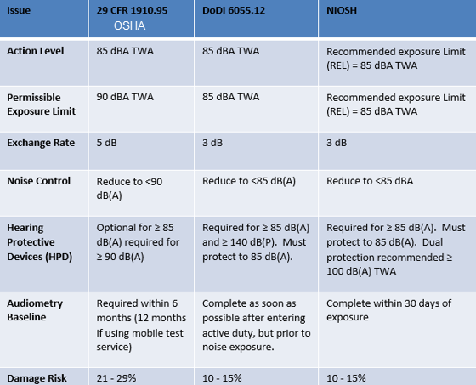
Notes:
Regulation/Best Practice: Display are some of the differences between OSHA, DoD, and what NIOSH recommends; although not all inclusive, some key differences are shown
(Hearing Conservation In Industry, Schools, and the Military, Table 5-4, The Development of Federal Noise Standards and Damage Risk Criteria p. 57)
Review issues/differences; Very important for CAOHC exam; Have the students follow along in their manual
Action Level/Permissible Exposure Limit
Action Level - NIOSH deems 85 dB(A) TWA to be the recommended exposure limit and does not recommend any permissible exposure above this level
Permissible Exposure Limit - DoD does not refer to 85 dB(A) as the recommended exposure limit, but treats is as both the action level and permissible exposure limit
AL and PEL are very important for CAOHC exam
Exchange Rate/Noise Controls
Exchange rate - OSHA is 5 dB, NIOSH and DoD is 3 dB
Noise controls under OSHA must reduce sound levels to below 90 dBA; NIOSH and DoD both require noise controls to reduce exposure to below 85 dB(A)
5 dB exchange rate is made up, not created from scientific testing; Exchange rate very important for CAOHC exam
Hearing Protection Devices (HPDs)
HPDs under OSHA must be available to employees who have exposures > 85 dB(A), use is not required until > 90 dB(A) unless pending a reference or had an positive STS
NIOSH and DoD require the use of HPDs for exposures > 85 dB(A)
DoD requires HPDs when peak sound pressure levels > 140 dB(P)
Engineering/Administrative controls
NIOSH recommends double hearing protection when exposures > 100 dB(A)
DoDI does not address double hearing protection and OSHA simply states that double hearing protection should be used in high noise environments
Army, Navy, Air Force, and Marine Service Specific regulations do address more specific hearing protection requirements
Audiometry Baseline
OSHA is required to be obtained within 6 months of exposure
Unless a mobile testing service is used, then the baseline needs to be obtained within one year of exposure
OSHA HPD use is required at an 85 dB(A) TWA if the employee has not received a baseline audiogram
NIOSH recommends completing the baseline within 30 days of exposure
DoD requires the baseline to be obtained as soon as possible after entering active duty
Prior to any noise exposure; At the service members first duty assignment (accession points)
DoD civilians require an audiometric baseline prior to exposure to hazardous noise
Damage Risk
Level of acceptable risk or the proportion of the exposed population that could be allowed to become materially impaired
Regulatory requirements are not 100% protective and that an estimated percent of the workforce will be materially impaired by following the applied regulation
Note above % is very high, should be less than 5% if compliant

Slide 15
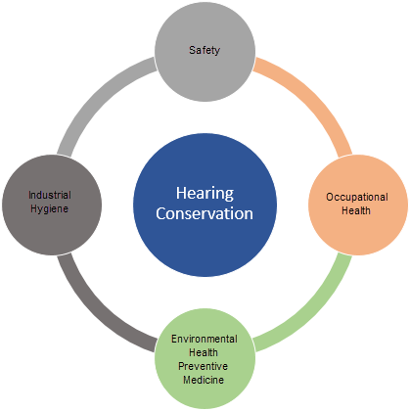
Regulations
In Support of the Hearing Conservation Program
Occupational Health - record keeping/reporting
Safety - personal protective devices/exposure/site specific
Environmental Health and/or Preventive Medicine - site specific environmental issues
Industrial Hygiene - noise measurement
Tri-Service Hearing Technician 4.2 Certification Course
Notes:
Multiple regulations may impact the hearing conservation program

Slide 16
Regulations
OHC Responsibility
Understand the regulations that apply to you, your patients and the hearing conservation program
Always adhere to the most stringent standard
Work closely with professionals
Know where to access all applicable regulations
Military OHCs should have a general working knowledge of all Service Specific hearing conservation program regulations including local HCP SOPs
Tri-Service Hearing Technician 4.2 Certification Course

Slide 17
Regulations
Web Resources
Occupational Safety and Health Administration (OSHA)
National Institute for Occupational Safety and Health (NIOSH)
Council for Accreditation in Occupational Hearing Conservation (CAOHC)
Hearing Center of Excellence (HCE)
Army Public Health Center (APHC)
Navy Marine Corps Public Health Center (NMCPHC)
Tri-Service Hearing Technician 4.2 Certification Course

Slide 18
Regulations
Summary
Federal Regulations
  OSHA
  NIOSH
State Regulations
Department of Defense Regulations
Service Specific
  Regulations
  Instructions/TMs
  Local level policies/SOPs
Tri-Service Hearing Technician 4.2.0.0 Certification Course

Slide 19
Regulations
? Questions ?
Tri-Service Hearing Technician
4.2 Certification Course

